Slide 1
Summary 16-09
Non maximality + priming experiment

Slide 2
Experimental items
TARGETS

Slide 3
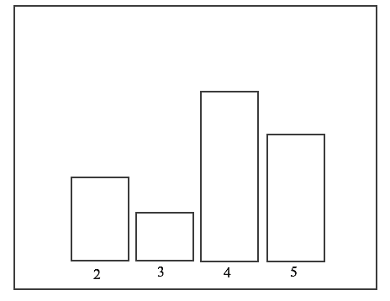
PREDICTIONS
Non Maximal Distributive readings (Distributive 2)
D-Max = Maximal readings of distributive predicates
D-NMax= Distributive Non Maximal readings, Distributive 2 (Targets)
STUDY 1: PRE-TEST
Can people access to non maximal readings with collective predicates?
% of True answers
All distributive vs. Baseline
D – Max
on
D – NMax
In case only phantom competition produces some sort of priming.
Study

Slide 4
Non Maximal Distributive readings (Distributive 2)
Distributive vs. Collective priming
Baseline vs. Collective priming
Difference between priming with Distributive Max and with any Collective
% of True answers
C- Max + NMax on D-NMax
Study

Slide 5
Non Maximal Distributive readings (Distributive 2)
C-Max = Maximal readings of collective predicates
D-Max = Maximal readings of distributive predicates
C-NonMax= Non Maximal readings of collective predicates
D-NonMax= Distributive 2 (Targets)
C-NMax on D-NMax
Difference between priming with Distributive Max and with any Collective
% of True answers
C-Max on D-NMax
Study

Slide 6
Non Maximal Distributive readings (Distributive 2)
C-Max = Maximal readings of collective predicates
D-Max = Maximal readings of distributive predicates
C-NonMax= Non Maximal readings of collective predicates
D-NonMax= Distributive 2 (Targets)
C-NMax on D-NMax
% of True answers
C- Max + NMax on D-NMax
C-Max on D-NMax
D – Max on D – NMax
Study

Slide 7
2: All Dist
3: Baseline
4: All Coll Primes
5: Nmax Coll Primes

Slide 8
Fillers

Slide 9
Some further observations about design:
For each study, we need two subgroups, for each predicate combination in target condition.
Differences between 1 and 2 target items = influence of image

